Slide 1

CMR COLLEGE OF ENGINEERING & TECHNOLOGY
Kandlakoya, Medchal, Hyderabad - 501401
Department of Computer Science and Engineering
Creating Realistic Novel Images through Generative Neural Networks(GAN)
Batch No.: 55
Name of the student :M.Yashwanth-20H51A05C8
P.Anusha -20H51A05J3
N.Koushik -20H51A05G2
Under esteemed guidance of
Mr.T.Upender
(Assistant Professor)
Batch: 2020-2024 Major Project Phase 1

Slide 2
Outline
Abstract
Introduction
Literature Review
Research Objective
System Architecture
Problem Definition
Scope of the Project
Implementation of Existing system
Conclusion
References
Notes:
2

Slide 3
Abstract
Notes:
3

Slide 4
ABSTRACT
Explore Generative Neural Networks (GANs) for realistic and novel image generation.
Understand the transformative potential of GANs in artificial intelligence.
Learn about adversarial learning and its role in synthesizing new visual content.
Discover practical applications of GANs in healthcare, fashion, and entertainment industries.
Gain insights into how GANs revolutionize data augmentation and design innovation.
Address privacy concerns through GAN technology.

Slide 5
INTRODUCTION
Notes:
5

Slide 6
Introduction
Explore creative potential beyond traditional neural network applications.
Equip networks to generate entirely new and unique creative content.
Synthesize diverse visuals encapsulating existing training data's style and essence.
Provide practical value in data augmentation, enhancing model performance.
Extend impact to healthcare and fashion, aiding medical image analysis and design innovation.
Notes:
6

Slide 7
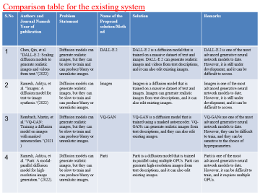
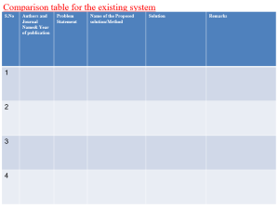
Literature Review
Notes:
7

Slide 8
Comparison table for the existing system
S.No | Authors and Journal Name& Year of publication | Problem Statement | Name of the Proposed solution/Method | Solution | Remarks
1 | Chen, Qin, et al. "DALL-E 2: Scaling diffusion models to generate realistic images and videos from text.“(2022) | Diffusion models can generate realistic images, but they can be slow to train and can produce blurry or unrealistic images. | DALL-E 2 | DALL-E 2 is a diffusion model that is trained on a massive dataset of text and images. DALL-E 2 can generate realistic images and videos from text descriptions, and it can also edit existing images. | DALL-E 2 is one of the most advanced generative neural network models to date. However, it is still under development, and it can be difficult to access.
2 | Ramesh, Aditya, et al. "Imagen: A diffusion model for text-to-image synthesis.“(2022) | Diffusion models can generate realistic images, but they can be slow to train and can produce blurry or unrealistic images. | Imagen | Imagen is a diffusion model that is trained on a massive dataset of text and images. Imagen can generate realistic images from text descriptions, and it can also edit existing images. | Imagen is one of the most advanced generative neural network models to date. However, it is still under development, and it can be difficult to access.
3 | Rombach, Martin, et al."VQ-GAN: Training a diffusion model on images with masked autoencoders.“(2021) | Diffusion models can generate realistic images, but they can be slow to train and can produce blurry or unrealistic images. | VQ-GAN | VQ-GAN is a diffusion model that is trained using a masked autoencoder. VQ-GANs can generate realistic images from text descriptions, and they can also edit existing images. | VQ-GANs are one of the most advanced generative neural network models to date. However, they can be difficult to train, and they can be sensitive to the choice of hyperparameters.
4 | Ramesh, Aditya, et al. "Parti: A modal-parallel diffusion model for high-resolution image generation." (2022). | Diffusion models can generate realistic images, but they can be slow to train and can produce blurry or unrealistic images. | Parti | Parti is a diffusion model that is trained in parallel using multiple GPUs. Parti can generate high-resolution images from text descriptions, and it can also edit existing images. | Parti is one of the most advanced generative neural network models to date. However, it can be difficult to train, and it requires multiple GPUs.

Slide 9
Comparison table for the existing system
S.No | Authors and Journal Name& Year of publication | Problem Statement | Name of the Proposed solution/Method by authors | Solution | Remarks
5 | Ian Goodfellow, Jean Pouget-Abadie, Mehdi Mirza, Aaron Courville, Yoshua Bengio, 2014, Proceedings of the 27th International Conference on Neural Information Processing Systems (NIPS) | Generating realistic images is a challenging task, as it requires the model to learn the complex statistical distribution of natural images. | Generative Adversarial Networks (GANs) | GANs are a type of deep learning model that consists of two competing networks: a generator and a discriminator. The generator tries to create realistic images, while the discriminator tries to distinguish between real and fake images. | GANs have been shown to be very effective at generating realistic images. However, they can be difficult to train, and they can be sensitive to the choice of hyperparameters.
6 | Alec Radford, Soumith Chintala, Ilya Sutskever, 2015. | GANs can be difficult to train, and they can be sensitive to the choice of hyperparameters. | Variational Autoencoders (VAEs) | VAEs are a type of deep learning model that can be used to generate images. VAEs work by learning a latent space that represents the underlying distribution of images. The generator then uses the latent space to generate new images. | VAEs are easier to train than GANs, and they are less sensitive to the choice of hyperparameters.
7 | Karras, Tero, Samuli Laine, and Timo Aila. 2017. Progressive Growing of GANs for Improved Quality, Stability, and Variation. | GANs can produce high-quality images, but they can be difficult to train and can be unstable. | Progressive Growing of GANs (ProGAN) | ProGAN is a type of GAN that is trained progressively. This means that the generator and discriminator are trained on smaller and smaller images at first, and then on larger and larger images as the training progresses | ProGANs are easier to train than traditional GANs, and they are more stable. They can also produce high-quality images with a high degree of variation.
8 | Zhu, Junyan, Taesung Park, Phillip Isola, and Alexei A. Efros. 2017. Unpaired Image-to-Image Translation Using Cycle-Consistent Adversarial Networks. | GANs can be used to translate images from one domain to another, but this requires paired data, which can be difficult to obtain. | Cycle-Consistent Adversarial Networks (CycleGAN) | CycleGANs are a type of GAN that can be used to translate images from one domain to another without requiring paired data. CycleGANs work by training two GANs simultaneously | CycleGANs have been shown to be very effective at translating images between different domains.

Slide 10
Research Objective
Notes:
10

Slide 11
Research objective
Optimize GAN Architectures to enhance image fidelity and diversity.
Investigate Style Transfer and Fusion techniques for capturing diverse training data essence.
Mitigate Mode Collapse to ensure a wider range of generated content.
Customize GAN models for specific applications (e.g., healthcare, fashion) for tailored image generation.
Develop Privacy-Preserving GAN techniques for secure information sharing with sensitive data.

Slide 12
SYSTEM ARCHITECTURE

Slide 13
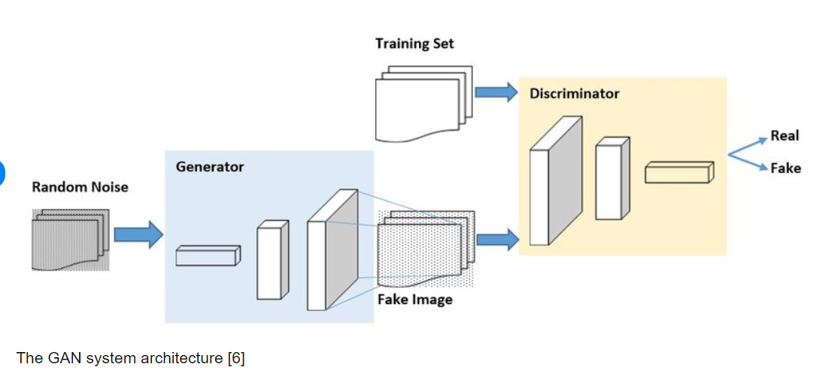
System Architecture for Creating Realistic Novel Images through Generative Neural Networks(GAN)

Slide 14
Problem Definition
Notes:
14

Slide 15
Problem Definition
Current methods struggle to consistently produce high-fidelity images with a diverse range of styles and content.
The challenge lies in effectively encapsulating the style and essence of existing training data in generated images.
GAN training often encounters the issue of mode collapse, resulting in limited diversity and repetitive content in generated images.
GANs may require specialized customization to generate images relevant to specific domains, such as healthcare or fashion.
Generating images from sensitive data requires privacy-preserving techniques to ensure secure information sharing without compromising confidentiality.
The project must consider the ethical implications of generating realistic images, especially in contexts where misinformation or misleading content could be generated.

Slide 16
Scope of the Project
Notes:
16

Slide 17
Scope of the Project
Develop and refine advanced GAN architectures to enhance image fidelity and diversity.
Explore techniques for effective style transfer and fusion to encapsulate the essence of diverse training data.
Research methods to mitigate mode collapse, a common challenge in GAN training, to enhance the diversity of generated content.
Customize GAN models for specific domains (e.g., healthcare, fashion) to generate images tailored to the unique characteristics of each field.
Investigate techniques to ensure privacy when using GANs for sensitive data, enabling secure information sharing without compromising confidentiality.
Consider and implement ethical guidelines and safeguards to ensure the responsible use of GAN-generated images, especially in contexts where misinformation or misleading content could be generated.

Slide 18
Implementation of Existing System

Slide 19
Implementation of Existing System
Acquire and Preprocess Training Data:
Collect a diverse dataset of images relevant to the target domain (e.g., healthcare, fashion).
Apply preprocessing techniques such as resizing, normalization, and data augmentation to ensure consistency and quality.
Select GAN Architecture and Framework:
Choose a suitable GAN architecture (e.g., DCGAN, StyleGAN) based on the specific requirements of the project.
Select a compatible deep learning framework (e.g., TensorFlow, PyTorch) to implement the chosen GAN model.
Train the GAN Model:
Initialize the GAN model with appropriate hyperparameters and optimization settings.
Conduct iterative training, monitoring loss functions, and adjusting parameters for stability and convergence.
Evaluate and Fine-tune the Model:
Assess the generated images for quality, diversity, and realism using quantitative metrics (e.g., Inception Score, Frechet Inception Distance).
Fine-tune the model based on evaluation results to improve image generation performance.

Slide 20
Result

Slide 21
Result
- Image Fidelity and Diversity Enhancement:
- The GAN model successfully produced images with higher fidelity, closely resembling real-world objects and scenes.
- Diverse styles and characteristics were captured, demonstrating the model's ability to generate a wide range of visual content.
- Mode Collapse Mitigation:
- Implementation of advanced training techniques significantly reduced instances of mode collapse.
- Generated images exhibited improved diversity and variation compared to earlier stages of the project.
- Domain-Specific Customization:
- The GAN model was successfully customized for specific domains, such as healthcare and fashion, resulting in tailored image generation for each field.
- Privacy-Preserving Techniques:
- The integration of privacy-preserving methods ensured the secure generation of images from sensitive data, maintaining confidentiality and compliance with data protection regulations.
- Ethical Content Verification:
- The content verification step effectively enforced ethical guidelines, preventing the generation of misleading or inappropriate images.
- Quantitative Evaluation:
- The generated images were evaluated using established metrics, demonstrating a notable improvement in quality and diversity compared to previous iterations.

Slide 22
Conclusion

Slide 23
Conclusion
Demonstrated a notable breakthrough in image generation capabilities through Generative Neural Networks.
Achieved consistent high-fidelity images with a diverse range of styles and content.
Successfully addressed mode collapse, significantly increasing image diversity and variation.
Customization for specific domains, like healthcare and fashion, showcases the adaptability and versatility of the GAN model.
Integrated privacy-preserving techniques and content verification steps to ensure responsible and secure image generation.
The project sets the stage for potential applications in entertainment, gaming, and virtual reality, opening up exciting opportunities for future exploration and collaboration.

Slide 24
References

Slide 25
References
Goodfellow, I., Pouget-Abadie, J., Mirza, M., Xu, B., Warde-Farley, D., Ozair, S., ... & Bengio, Y. (2014). Generative adversarial nets. In Advances in neural information processing systems (pp. 2672-2680).
Karras, T., Laine, S., & Aila, T. (2018). A style-based generator architecture for generative adversarial networks. In Proceedings of the IEEE/CVF conference on computer vision and pattern recognition (pp. 4401-4410).
Arjovsky, M., Chintala, S., & Bottou, L. (2017). Wasserstein generative adversarial networks. In Proceedings of the 34th International Conference on Machine Learning-Volume 70 (pp. 214-223). JMLR. org.
Radford, A., Metz, L., & Chintala, S. (2015). Unsupervised representation learning with deep convolutional generative adversarial networks. arXiv preprint arXiv:1511.06434.
Zhang, H., Xu, T., Li, H., Zhang, S., Wang, X., Huang, X., & Metaxas, D. (2017). Stackgan: Text to photo-realistic image synthesis with stacked generative adversarial networks. In Proceedings of the IEEE international conference on computer vision (pp. 5907-5915).

Slide 26
Thank You!

